Slide 2
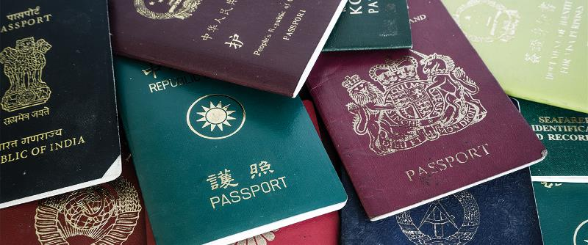
Office of International Programs​
Staying Legal in Lebanon

Slide 3
Office of International Programs​
Staying Legal in Lebanon
Visas
OIP offers visa and residence permit support to all incoming international students.
Lebanon is considered to be one of the most lenient countries with regards to issuing visas and accepting visa extensions. However, the bureaucracy is a bit unsatisfying – to say the least.
General Security, whose tasks resemble the tasks of some agencies under Homeland Security in the U.S and several ministries/government entities in Europe, is the sole authority responsible for visa and residence permit issuing in Lebanon.
A visa is a conditional permission granted to foreigners by a host country. It includes limits on the duration of stay and the number of permitted visits within that duration You are expected to leave the country or apply for a temporary extension when it expires.

Slide 4
Office of International Programs​
Staying Legal in Lebanon
Visas
2. A six-months visa obtained from the Lebanese Embassy/Consulate should be enough for VIS/EXCH students who are here for one term OR two terms. However, it is recommended that students who wish to study at AUB for more than one term apply for a yearly student residence permit before the expiration date of their visa.
3. One of the services that OIP offers regarding visas is the OIP-assisted one-month single-entry visa. This visa entitles its holder to a total of 30 days on the sole condition that the holder applies for a student residence permit before the expiration date of their visa. More information is available on the OIP website – Visas webpage.

Slide 5
Office of International Programs​
Staying Legal in Lebanon
Residence Permits
A student residence permit is a permit issued by General Security that allows you to study in Lebanon for a maximum of 12 months. This should be done on a yearly basis.
Degree-seeking students and/or VIS/EXCH students who are here for two consecutive terms, who have entered Lebanon on a free one-month single entry visa, are strongly encouraged to apply for a yearly student residence permit as soon as they begin their term at AUB and before their visa expires.

Slide 6
Office of International Programs​
Staying Legal in Lebanon
Residence Permits
Through the regular process and under normal circumstances, residence permit applications take between 4-8 weeks to be processed. You will have to submit the application to General Security and retrieve the permit yourself. The permit itself costs 10,000,000 LBP plus other various expenses mounting to approximately 15,000,000 LBP.
The OIP-assisted RP would only take seven to fourteen working days and you will have to pay an extra 4,900,000 LBP to General Security as an expedition fee.
a. First-timers will need to go in person and will require OIP’s representative to accompany them to GS. OIP can retrieve their permits for them when issued.
b. Renewing students can submit their full applications to OIP and can collect it from our office instead of going to General Security
A residence permit checklist and the forms applicants need to fill out are posted on OIP’s webpage.
OIP has no control over the process nor over the decisions taken by General Security (i.e. denying or accepting residence permit applications). However, OIP will provide full support and guidance throughout the process.
If you plan on applying for a student residence permit, make sure you comply with the Ministry of Education and Higher Education’s directives concerning authentication of degrees (please refer to the welcome email you received from the Registrar's and the Preparations email you received from OIP).

Slide 7
Thank you

